Slide 1
Normalizing Microtext
Zhenzhen Xue, Dawei Yin and Brian D. Davison
Lehigh University

Slide 2
Introduction
Microtext
  Informal written text
  Limited length
  E.g., Tweets, texting messages, online chat messages
High proportion of Non-Standard Words (NSWs)
  Misspellings, slang, abbreviations, etc.
  Difficult for machines (and sometimes humans!) to understand
Challenge for NLP algorithms
  Tasks such as Named Entity Recognition have been reported to have lower performance on Microtext than on structured text

Slide 3
Examples
Hard to define the boundary between NSWs and Standard Words
  Widely used acronyms (e.g., PhD, ATM, CD, BMW, etc)
Non Standard Words | Standard Words
c u 2nite | See you tonight
l8t | late
msg | message
plz | please
enuf | enough
gooooood | good
wrk | work
Lol | laugh out loud
asap | As soon as possible

Slide 4
Related Work
General Text Normalization
  Deals with tokens such as numbers, abbreviations, dates, currency amounts, etc
Spelling Correction
  Relies on spelling lexicon to detect misspelled tokens
SMS Normalization
  Three approaches
    Spelling correction (Choudhury et al. 2007; Cook and Stevenson 2009)
    Machine translation (Aw et al. 2006)
    Automatic speech recognition (Kobus et al. 2008)

Slide 5

Normalization Model (1)
Assuming the Noisy Channel Model
  Find the most probable normalization t* for each observed term t’
Notes:
Using Bayes Rule, we can ask for the t that maximizes P(observed word given the intended word t) * P(intended word)

Slide 6
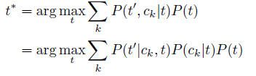
Normalization Model (2)
Multiple channels
  Grapheme Channel
  Phoneme Channel
  Context Channel
  Acronym Channel
Channel Model
The probability of term t being transferred through channel ck
Notes:
Each of these channels can have a similar model.

Slide 7


Channel Model – Grapheme Channel
Models the distortion of spellings
Channel Model
Longest Common Subsequence Ratio
Levenshtein Distance
Consonant Skeleton
Notes:
Similarity between distorted word and possible intended word
Edit distance
Consonant Skeleton

Slide 8
Channel Model – Grapheme Channel
Models the distortion of spellings
Channel Model
EXAMPLE
Word: Plz
Candidate: Please
LCSRatio: 2/6
CS(Word): Plz
CS(Candidate): Pls
Distance: 1 substitution
Similarity: 1/3
EXAMPLE
Word: Plz
Candidate: Pulls
LCSRatio: 1/5
CS(Word): Plz
CS(Candidate): Pls
Distance: 1 substitution
Similarity: 1/5

Slide 9

Channel Model – Phoneme Channel
Models the distortion of pronunciations
Channel Model
Letter-To-Phoneme conversion *
* Rama, T.; Singh, A. K.; and Kolachina, S. 2009. Modeling letter-to-phoneme conversion as a phrase based statistical machine translation problem with minimum error rate training. In NAACL ’09.

Slide 10

Channel Model – Context Channel
Incorporates context information
Channel Model
Observed Word | Candidates | Contexts & Normalizations
yr | your, year | It’s yr (your) turn Happy new yr (year)
wll | will, well, wall | I wll (will) leave
bin | bin, been | Have bin (been) really happy since…
no | no, know | Don’t no (know) why
Context probability based on language models (e.g., Microsoft Web N-gram Service)

Slide 11

Channel Model – Acronym Channel
Word to phrase (one-to-many) normalization
  E.g., ASAP, FYI, LOL
Channel Model
A set of popular acronyms collected from http://www.webopedia.com/quick ref/textmessageabbreviations.asp

Slide 12
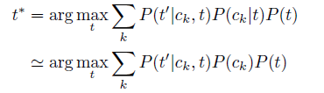
Channel Probabilities – Generic
Term independent channel probability
Notes:
Assume that the choice of channel is independent of the term to be transmitted

Slide 13


Channel Probabilities – Term Dependent
Learn term dependent channel probabilities from training data
Objective function
Notes:
Term independence might be a big assumption, so we also modeled term dependent channel probabilities.
Maximize the difference between correct and all incorrect term choices
Grapheme, Phoneme, Context, Acronym

Slide 14
Combining Channels
Objective function
Notes:
Term independence might be a big assumption, so we also modeled term dependent channel probabilities.
Maximize the difference between correct and all incorrect term choices
Grapheme, Phoneme, Context, Acronym

Slide 15
Experiments
Two Datasets
  818 Tweets collected in Sept. 2010
    254 (31%) Tweets need normalizations
    A total of 479 word transformations
  A public SMS dataset
    A training set of 854 text messages, and a test set of 138 messages
    127 (92%) messages need normalization in the test set
    An average of 4 word transformations per message
Comparison algorithms
  Aspell
  Moses (a competitive machine translation toolkit)

Slide 16
Results
 |  | Accuracy | F-measure | Precision | Recall
Twitter Dataset | Default | 0.70 | N/A | N/A | N/A
 | Aspell | 0.92 | 0.06 | 0.08 | 0.05
 | Moses | 0.94 | 0.41 | 0.76 | 0.28
 | MC-TD* | 0.96 | 0.61 | 0.50 | 0.79
SMS Dataset | Default | 0.60 | N/A | N/A | N/A
 | Aspell | 0.63 | 0.13 | 0.23 | 0.09
 | Choudhury07 | 0.86 | N/A | N/A | N/A
 | Moses | 0.92 | 0.87 | 0.88 | 0.86
 | MC-TD | 0.96 | 0.91 | 0.93 | 0.90
*MC-TD: Our Multi-Channel Model with Term-Dependent Probabilities
Notes:
Accuracy is measured over all words, and most words are correct and we leave them alone, giving good accuracy. Precision and recall are a function of the number and choice of words selected to correct and whether the correction is made correctly.
We can reduce the error rate on Twitter by 1/3 (from 6% to 4%) and ½ on SMS (from 8% to 4%) over the machine translation approach.

Slide 17
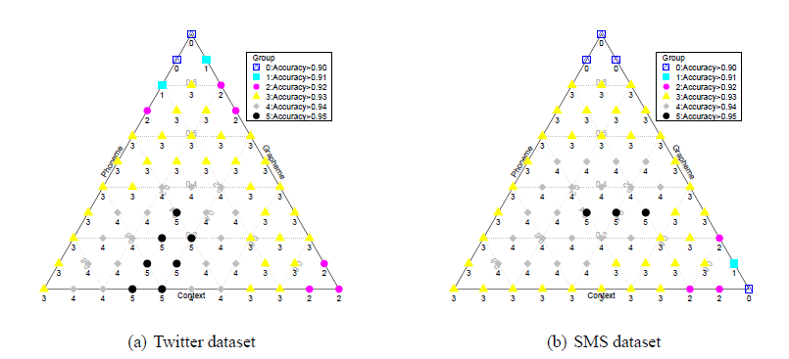
Importance of The Three Channels
Notes:
Consider Phoneme, Grapheme, and Context. If we emphasize Context on Twitter and no weight on the others, we get performance in class 0. If we weight Phoneme .3 or .4 and Grapheme .4 or more, we get performance of class 5. Shows that P&G are important to Twitter results. SMS needs all three.

Slide 18
Conclusions and Future Work
The multi-channel model outperforms baseline algorithms on two typical datasets
All four factors—orthographic, phonetic, contextual information and acronym expansion—are important
Optimization of Levenshtein Distance operator weights
  In both Grapheme and Phoneme channels
Look at dialects—differences in NSWs based on geography or other sub-population
Similar work was published by Han and Baldwin in ACL this summer—useful to compare under same data

Slide 19

Thank You!
Brian D. Davison
davison@cse.lehigh.edu

