Slide 1
Through the Twitter Glass
Detecting Questions in Micro-text
Kyle Dent <kdent@parc.com>
Notes:
Kyle Dent * Knowledge, Language, and Interaction group * Palo Alto Research Center.

Slide 2


Original Question: Do people use Twitter to ask questions?
First Answer: Of course.
  But to what extent and what kinds of questions?
“Is Twitter a Good Place for Asking Questions? A Characterization Study”, Sharoda A. Paul, Lichan Hong, and Ed H. Chi (ICWSM)
  Entertainment, technology, personal, health
  Majority receive no response while a small number receive very high response
  Larger networks generate more responses, but number of postings or frequency is not a factor

Slide 3
Spin-off Question: Can NLP detect questions on Twitter?
Syntactically valid question might indicate an information-seeking question
Spoiler Alert: Not really.
  “In the UK when you need to see a specialist do you need special forms or permission?”
  “What are the chances of both of my phones going off at the same time?? Smh in a minor meeting... Ugh!”
  “How has everyone's day gone so far? Today is going too fast for me!”
  Statements can be seeking information too.

Slide 4
Implied question: Can traditional NLP be used effectively on tweets?
Challenges for NLP are well-understood
  Parsing is mostly cubic operation
  Ambiguities in language
  Specialized language in different domains
Characteristics of Twitter might make the problem easier
  140-character limit constraint
  Limited domain

Slide 5
NLP Challenges
The trunks being now ready, he, after kissing his mother and sisters, and once more pressing to his bosom his adored Gretchen, who, dressed in simple white muslin, with a single tuberose in the ample folds of her rich brown hair, had tottered feebly down the stairs, still pale from the terror and excitement of the past evening, but longing to lay her poor aching head yet once again upon the breast of him whom she loved more dearly than life itself, departed.
The Awful German Language - Mark Twain

Slide 6
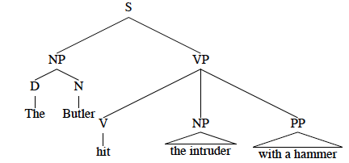
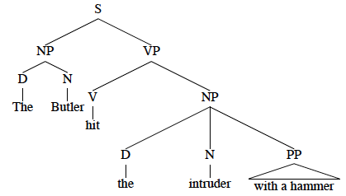
NLP Challenges
“The butler hit the intruder with a hammer.”

Slide 7
NLP Challenges
“The patient was asked to bring her pathology slides for review here at the clinic and also an updated report .”

Slide 8
Twitter Challenges
“Cake?@Username K gotta get the hair,eyebrows n nails done today b4 9 then I WISH I had sum one I could go CAKE wit :( sigh”
“#IHateWhen I tell ppl I LOST SUMTHNG nd the 1st thng they ask me is WHERE U LOST IT AT? smh, if I knu i wouldn't b telln u I LOST IT @DUMMY”
“*Thinks he may change his jeans.....stands looking in the mirror* does my bottom look big in these?”

Slide 9
Twitter Serious Challenges
“LOL Is there any room in this pocket for a little spare Chang?”
“Want some chocolate”

Slide 10
Classic NLP Tool Chain

Slide 11
Tokenizer
“That What I Was Looking 4 :) --&gt; @smohkim: What’s The Latest Book Published? Find It Out At Any New #Books [#Startup] http://ff.im/-rRR4c”
“Omg... Today has OFFICIALLY been the most wasted day ever... Why am I even @ work?? Smdh”
Spacing is often irregular:
  wr…ermm…NOT
  early.isnt
  note,credit

Slide 12
Lemmatizer
Shouuutout pleaaaaaaase?? (@kierangaffers live on http://twitcam.com/2cdpi)
Original | Lemma
pleaaaaase | please
spelling | speling
fell | fel
feel | fel
bee | be
be | be
we’re | were
were | were

Slide 13
Lexicon
Comprised of three separate word lists
  92,000 list of words and POS
  Twitter-specific words
  92,000 list of people’s names
All words subject to the lemmatization transformations
  Unification of POS tags
New POS tags
  e.g. PPBE for Im (I’m)

Slide 14
Parser
Minimal parser
Designed to find questions only
Primary goal was to determine viability
500 rewrite rules
Identifies question types:
  wh-questions
  Auxiliary-initial
  Be-initial
  Tag questions

Slide 15
Parser
hows | wats | whatre | wheres
whtcha | wasup | wazat | whats
whos | wtf | watcha | whatare
whatz | whose

Slide 16
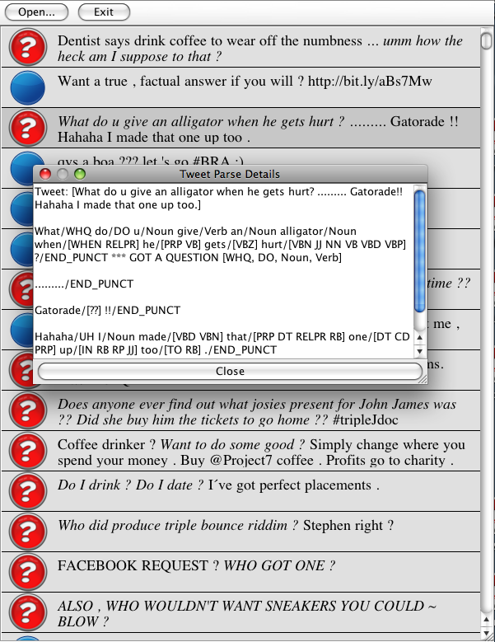

Slide 17
Results
 | MT Question | MT Not Question
Parser Question | 898 | 486
Parser Not Question | 254 | 666
Precision: .64884
Recall: .77951
Accuracy: .67881

Slide 18
Future
Or, combine the current code with machine learning for question detection
Get a real parser working
- test its accuracy on questions and other things

Slide 19
Thank you.

